Slide 1
SAMPLE KPI MEETING:
Email Marketing
Q2 KPI Summary Report
Month 00, 2020

Slide 2
Agenda
- Review Overall Q2 Metrics
- Review Metrics by Category
- Review Top/Bottom Q2 Performers
- Review A/B Test Results
- Review Email Marketing Roadmap
- Next Steps / Questions

Slide 3
Q2 Email Metrics
04/01/2020 – 06/30/2020

Slide 4
Metrics Review
Metric | Q2 | Industry Benchmark | % to Benchmark
Total Sent | X,XXX | N/A
# of Campaigns | XX | N/A
Open Rate | XX.X% | 25.5%
Click to Open Rate | XX.X% | 9.5%
Clickthrough Rate | X.XX% | 2.8%
Delivery Rate | X.XX% | 0.17%
Unsubscribe Rate | X.XX% | 0.10%
Key Takeaways:
No client facing emails sent out of Adestra in Q1
New “All Client List” resulted in a large number of bounces which have since been cleaned out of the list
Open rates are 33% lower than industry standards, recommend reviewing contact information for clients and confirming we have the most up-to-date info
Despite low open rates, click to sent and click to opens (up 212%!) are above benchmark. Clients are engaging with email content after opening.
Unsubscribe rate is a high – but this may be a result of new email cadence and establishing a clean client list. Monitor in Q3 to confirm it stabilizes

Slide 5
Metrics by Category
Email Type | # Sent | Open Rate | Click to Open Rate | Conversion Type | Conversion Rate | Unsubscribe
Email Category 1 | X,XXX | XX% | X.XX% | Registration | X.XX% | X.XX%
Email Category 2 | X,XXX | XX% | X.XX% | Purchase | X.XX% | X.XX%
Email Category 3 | X,XXX | XX% | X.XX% | Download | X.XX% | X.XX%
Email Category 4 | X,XXX | XX% | X.XX% | Page Visit | X.XX% | X.XX%

Slide 6
Metrics by SEGMENT
Email Type | # Sent | Open Rate | Click to Open Rate | Conversion Rate | Unsubscribe
Segment 1 | X,XXX | XX% | X.XX% | X.XX% | X.XX%
Segment 2 | X,XXX | XX% | X.XX% | X.XX% | X.XX%
Segment 3 | X,XXX | XX% | X.XX% | X.XX% | X.XX%
Segment 4 | X,XXX | XX% | X.XX% | X.XX% | X.XX%
Segment 5 | X,XXX | XX% | X.XX% | X.XX% | X.XX%
Segment 6 | X,XXX | XX% | X.XX% | X.XX% | X.XX%
Segment 7 | X,XXX | XX% | X.XX% | X.XX% | X.XX%

Slide 7
Automation Program SUMMARY
Email Type | # Sent | Open Rate | Click to Open Rate | Conversion Type | Conversion Rate | Unsubscribe
Program 1 | X,XXX | XX% | X.XX% | Registration | X.XX% | X.XX%
Program 2 | X,XXX | XX% | X.XX% | Purchase | X.XX% | X.XX%
Program 3 | X,XXX | XX% | X.XX% | Download | X.XX% | X.XX%
Program 4 | X,XXX | XX% | X.XX% | Page Visit | X.XX% | X.XX%
Program 5 | X,XXX | XX% | X.XX% | Registration | X.XX% | X.XX%
Program 6 | X,XXX | XX% | X.XX% | Purchase | X.XX% | X.XX%

Slide 8
AUTOMATION Program 1 REPORT
VISUAL
Email | # Sent | Open Rate | Click to Open Rate | Conversion Type | Conversion Rate | Unsubscribe
Email 1 | X,XXX | XX% | X.XX% | Registration | X.XX% | X.XX%
Email 2 | X,XXX | XX% | X.XX% | Purchase | X.XX% | X.XX%
Email 3 | X,XXX | XX% | X.XX% | Download | X.XX% | X.XX%
Email 4 | X,XXX | XX% | X.XX% | Page Visit | X.XX% | X.XX%
Total | SUM | AVG | AVG | N/A | AVG | AVG
Key Takeaways:

Slide 9
Top Performers by open rate
Subject Line | Open Rate
Email 1 Subject Line | XX.X%
Email 2 Subject Line | XX.X%
Email 3 Subject Line | XX.X%
Email 4 Subject Line | XX.X%
Email 5 Subject Line | XX.X%
Email 6 Subject Line | XX.X%
Email 7 Subject Line | XX.X%
Email 8 Subject Line | XX.X%
Email 9 Subject Line | XX.X%
Email 10 Subject Line | XX.X%
Email 11 Subject Line | XX.X%
Email 12 Subject Line | XX.X%
Key Takeaways:
Webinar emails had highest opens likely because they targeted more focused list (clients who registered for the event)
“Figuring Out Economic Impact” may have performed best due to relevancy and timeliness to current events
NOTICE: Domain Delegation Changes attracted attention due to nature of topic – account related
Deliverability Email seems to be a topic of interest to clients, continue deliverability and educational content sends
“Last Call to Register” did not drive much interest, may not be worth sending follow up to registration

Slide 10
Top Performers by Clicks
Campaign | Click to Open Rate
Email 1 | XX.X%
Email 2 | XX.X%
Email 3 | XX.X%
Email 4 | XX.X%
Email 5 | XX.X%
Email 6 | XX.X%
Email 7 | XX.X%
Email 8 | XX.X%
Email 9 | XX.X%
Email 10 | XX.X%
Email 11 | XX.X%
Email 12 | XX.X%
Key Takeaways:
Webinar emails had highest opens likely because they targeted more focused list (clients who registered for the event)
“Figuring Out Economic Impact” may have performed best due to relevancy and timeliness to current events
NOTICE: Domain Delegation Changes attracted attention due to nature of topic – account related
Deliverability Email seems to be a topic of interest to clients, continue deliverability and educational content sends
“Last Call to Register” did not drive much interest, may not be worth sending follow up to registration

Slide 11
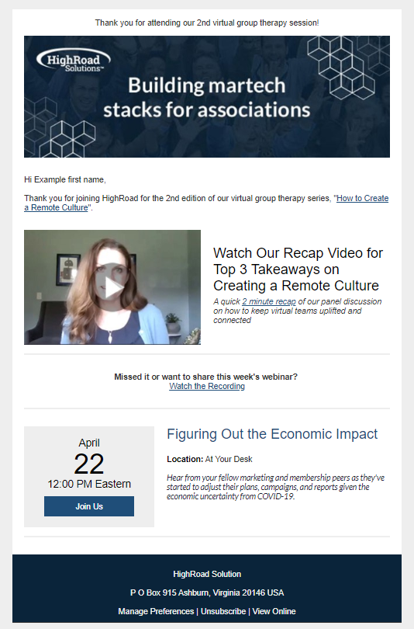
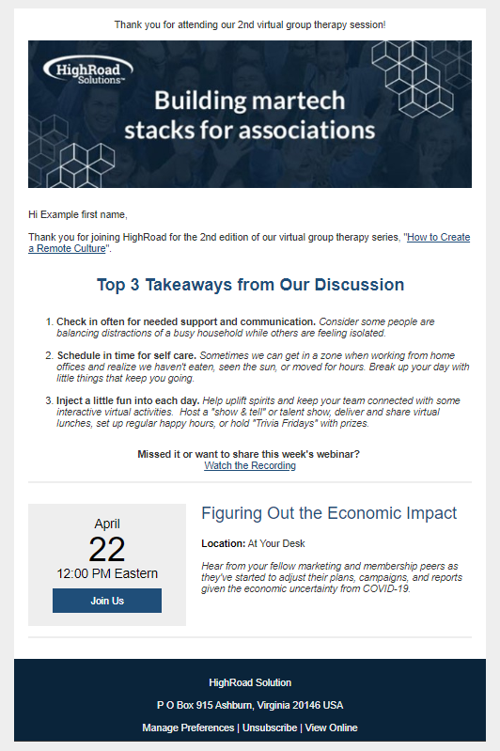
Version A
Version B
Test Date: 4/10/20
Test Variables:
Test text recap vs. video recap – clickthrough rate will determine winner. 10% sample size
Prediction/Hypothesis:
Version B will win as the video is more interactive and engaging
Results & Takeaways:
Variation A performed 93% better than the original version.
 | A | B
Sent | 2015 | 2015
Open % | 624 (31%) | 503 (25%)
CTR % | 125 (6%) | 241 (12%)

Slide 12
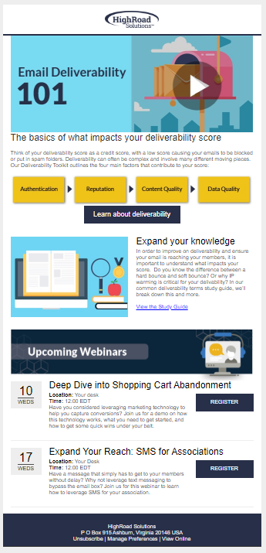
Version A
How to keep your emails out of spam folders
Test Date: 6/10/20
Test Variables:
Subject Line Test - statement vs. question. Open rate will determine winner. 50% sample size
Prediction/Hypothesis:
Version B (question) will win – more intriguing to recipient
Version B
Why are my emails going to spam?
Results & Takeaways:
Version B (question) won by 17%. Remainder sent with this subject line. Continue testing to validate insights.
 | A | B
Sent | 417 | 417
Open % | 52 (12%) | 61 (15%)
CTR % | 13 (3.1%) | 28 (6.7%)

Slide 13
Email Campaigns - Visuals

Slide 14
Email Type 1
Notes:
Send feedback requests to build member profiles
Continuously collect and develop your member profiles through surveys and campaigns designed to solicit feedback around interests and preferences.

Slide 15
Email Type 2
Notes:
Send feedback requests to build member profiles
Continuously collect and develop your member profiles through surveys and campaigns designed to solicit feedback around interests and preferences.

Slide 16
Email Type 3
Notes:
Send feedback requests to build member profiles
Continuously collect and develop your member profiles through surveys and campaigns designed to solicit feedback around interests and preferences.

Slide 17
Email Project Roadmap

Slide 18
PROJECT NAME
Project:
Description of project goes here
Objective:
List out goals and objectives for completing this project
Status:
Status goes here
Estimated Go Live:
Date for go live goes here

Slide 19
PROJECT Steps
1
Step 1 Description
Step 2 Description
2
Step 3 Description
3
4
Step 4 Description
6
Step 6 Description
5
Step 5 Description

Slide 20
Questions?

