Slide 1




Business Requirements

Slide 2


Agenda
Process
Business Rules
Email Preference Center (EPC)
Exercise

Slide 3
1
Process

Slide 4
Translating your objectives into data
4
3
2
Sync
Connect data
Between the
two systems
1
Data
Objectives
Map data sources,
location and
extraction
Identify and define what data will drive your campaigns
Flow
Understand how data moves from system to system
the what: marketing
the how: tech

Slide 5







Plus Connector.
How it works.
Email
Distribution
User Interaction
with Email
Adestra
AMS
Email Preference Center

Slide 6

Plus Connector.
Centralizes two worlds of data to give you access to the full picture.
(AMS)
Data collected through membership application
Adestra (Email Automation Platform)
Data collected as users interact with your content
Job Function
Opened an email
Certifications held
Clicked on a link
Engagement score
03
Visited a landing page
Member thru
Converted

Slide 7
Plus Connector
Components
Pre-segmentation
Commonly used lists
(i.e. members, volunteers, registrants, etc.)
All customer
Entire universe
(fields)
Email Preference Center
Opt-ins, opt-downs, unsubscribes

Slide 8
2
Business Rules

Slide 9
Who?
Who should flow into Adestra from AM.Net (need valid email address and opt-in)?
Everyone
Members
Volunteers
Customers
Prospects

Slide 10
What?
When they come over, what data attributes need to come with them (first name, last name, email address are defaults)?
Demographics (personalization)
  First name
  Company Name
  Member ID
Behavioral (segmentation):
  Member activities (events, etc.)
  Interests (focus areas, etc.)
  Volunteer activity

Slide 11
Example Fields
First Name
Last Name
Email Address
Member ID
Company
Title / Position
Company Type
Special Interests
Job Level
Job Function
Geography
Certifications
Member Status/Level
Activities:
  Type of Events/Transactions
  Type of Volunteership
  Type of Training
  Type of Standard
  Type of Product

Slide 12
How?
In most cases, it’ll be a combination of the three options:
What will be coming over as fields and field attributes?
What will be coming over as pre-segmentation lists?
What will be coming over as Queries within AM.Net?

Slide 13
3
Email Preference
Center (EPC)

Slide 14
What is an EPC?
An Email Preference Center is a centralized location where users can manage their communications preferences and topical interests.

Slide 15
Why use an EPC?
Adhere
Stay compliant with GDPR and other communication policies
Target
Build buyer journeys
around self-selected
topic preferences
Retain
Push the programs that
align with your member for
greater retention and less global opt-outs
Customize
Individualize your users’ experience with your organization
‹#›

Slide 16
How to best promote
your EPC?
Centralize
Add your EPC to your member profile area.
Synchronize
Externalize
Integrate EPC
campaigns into your communications calendar
Promote your Email Preference Center to non-members (i.e. website)

Slide 17
How to structure your EPC?
Audience
Members
Customers
Prospects
Structure
By focus areas/topics
By programs (i.e. events)
By communication types (i.e. newsletters)
By audiences (i.e. specific job titles)
Alerts
Language that they’re about to opt-out of all member cx, etc.
Industry Standards
Stay between 5-15 overall categories
Sub-categories are recommended
Opt-in default to primary category

Slide 18
Dynamic options
Flex
Triggers your EPC page to display differently depending on who’s looking at the page.
Scenario: Your EPC shows member newsletters only to those who are members. A non-member can view the EPC page but will not see the member newsletter.
Pivot
Allows those into your EPC who are
not already in your AMS.
Scenario: You want your EPC available to the public (members, customers, non-members) and are using it as a member cx tool and an awareness tool.

Slide 19

An EPC is a compliance tool
With this said, the tool can also be used to generate leads, and increase member engagement and renewals.

Slide 20
What are your goals for the EPC?
What are you intended audiences for the EPC?
Are you looking to generating net new leads?
Are you looking to collect more information on your members?
Are you looking to promote via in-house advertising?
Are you looking to track the EPC page?

Slide 21
Email Preference Center
EPC Standard Example
HighRoad Updates
Company announcements
Product roadmap
Products & Solutions
Adestra
Blue Hornet
ICE Newsletter
Plus Connector
SharpSpring
Shopping Cart
SMS Texting
Educational Events
Webinars
Workshops
Center of Excellence
Data segmentation
Content marketing
Deliverability practices
Goal setting & tracking
Lead gen & sales
Member engagement
New tools & technologies
Services
Data management
Email automation
Marketing automation
Digital marketing
Technology adoption
Individualizes your members’ experiences
Weekly Blog Digest Digest
Keeps you compliant
I no longer want to receive emails from HighRoad

Slide 22
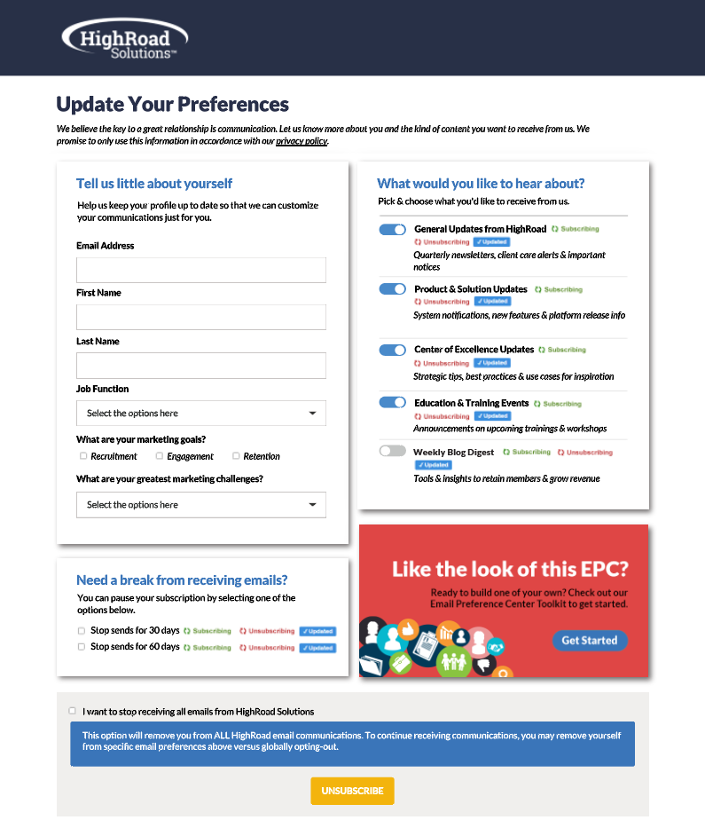
EPC
Elevated
Example
Member experience
Lead gen and/or client data collection
In-house advertising
Frequency management
Compliance

Slide 23
4
Exercise

Slide 24
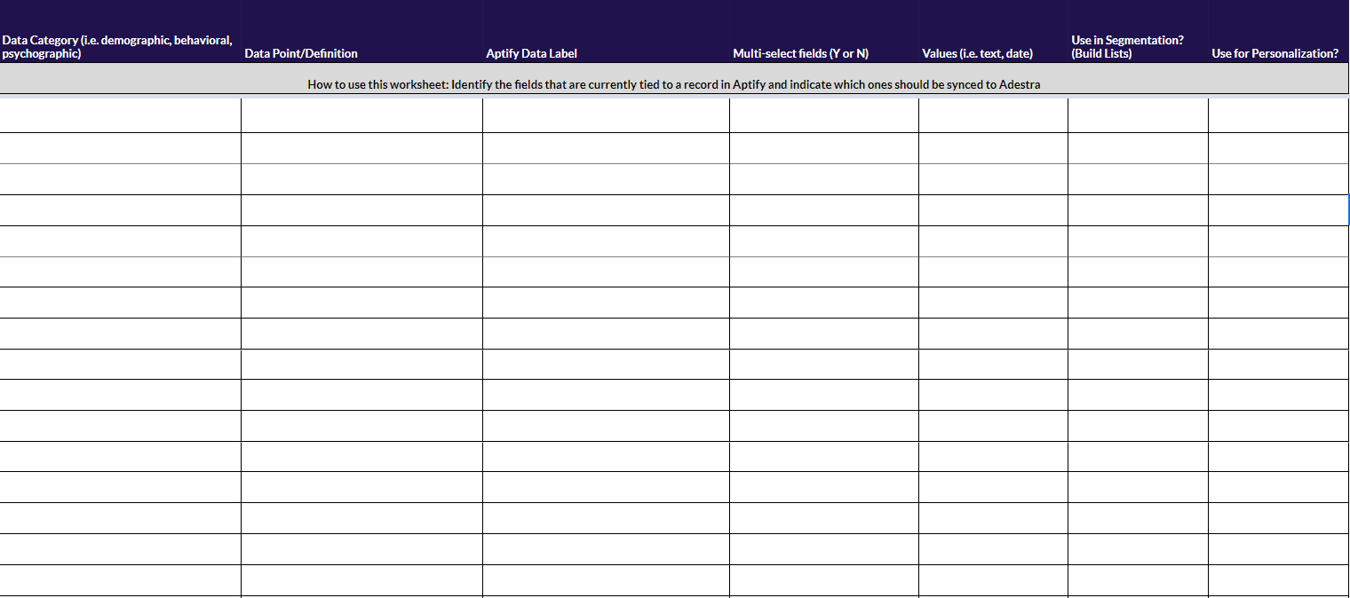
Exercise
CLICK HERE FOR WORKBOOK

Slide 25

Next Steps
ORCPA to fill out first draft of Business Requirements worksheet

